Slide 1
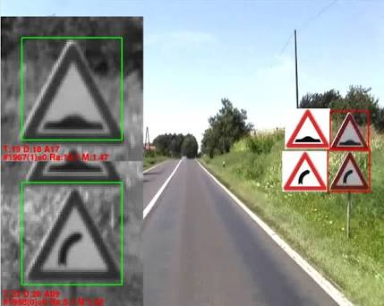
Road Symbol Detection in Vehicle
Team Data Knights

Slide 2
Modules
Symbol Detection and Voice Generation (confidence score determination for each prediction)
Geo-location based symbol prediction (if confidence is <50%)
Suspicious vehicle detection and reporting (Number plate recognition)

Slide 3
Characteristics/USPs
Symbol detection is fully capable of working offline in the vehicle
It is capable of working with interrupted internet connection as well
It can work on both batch and streaming data
It can identify suspicious vehicles on the roads
Geolocation data can be used to monitor near real-time track of road activities

Slide 4
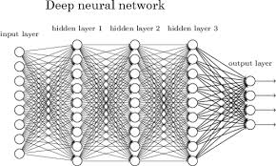
Technologies Used
Python
Deep Learning – CNN
Machine Learning – KNN
Android
Flask
Linux

Slide 5
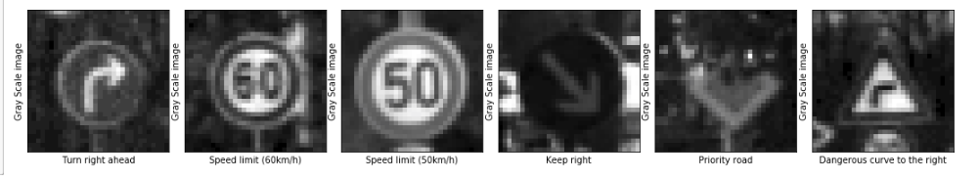
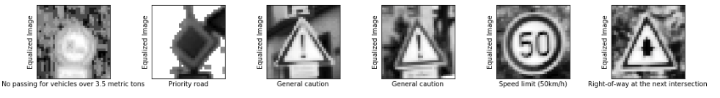
Data Samples

Slide 6
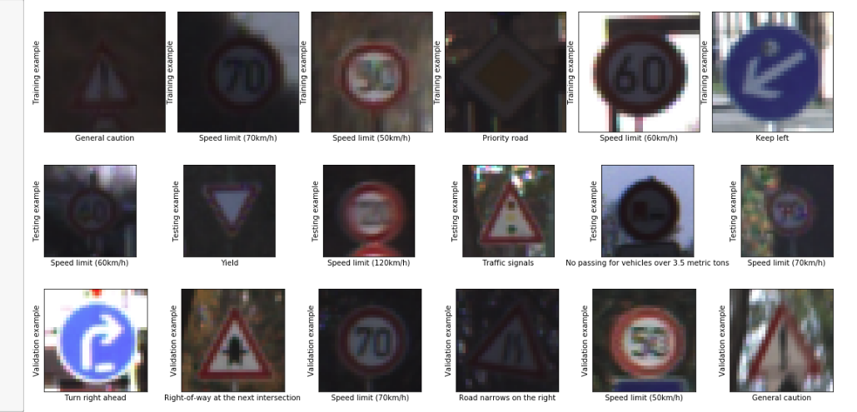

Slide 7
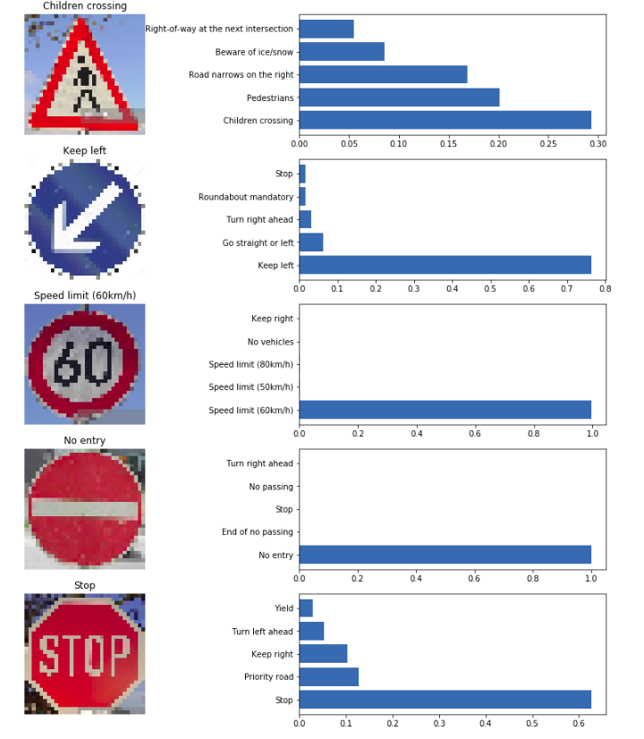
Symbol Detection
Using VGGNet based classifier to classify the image dataset collected from web
It gives the probabilities of most likely outcome

Slide 8
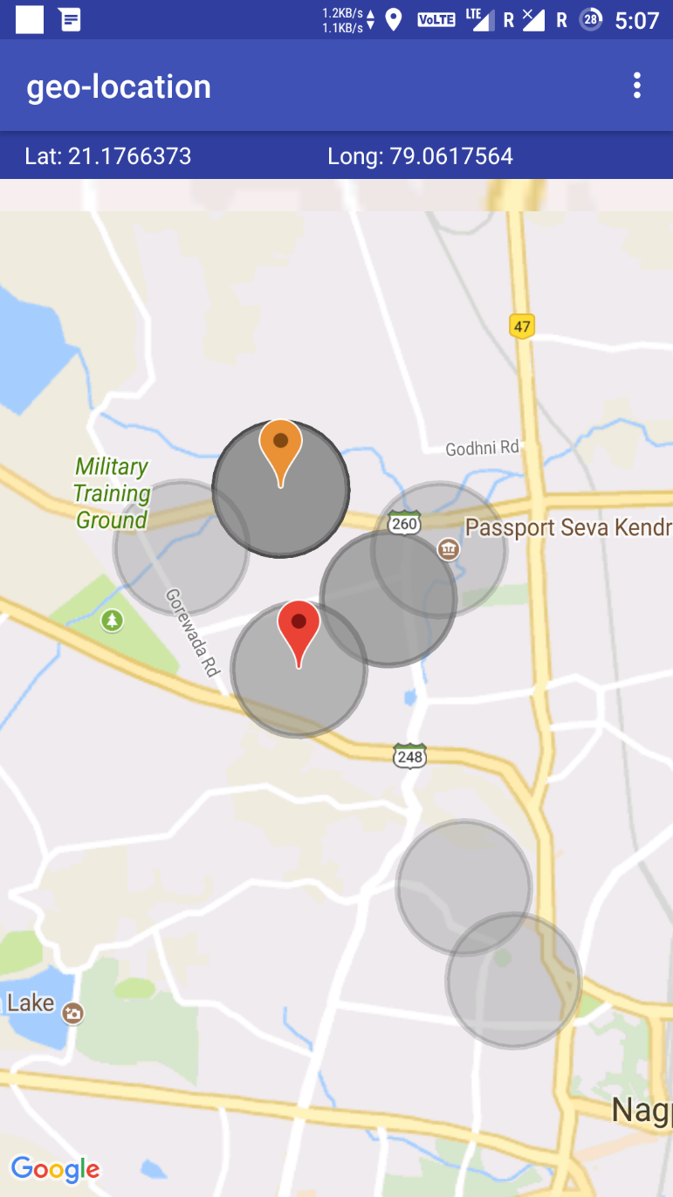
Android App
Using android app to geo-locate and classify the zones having possible symbols
Voice is generated accordingly

Slide 9
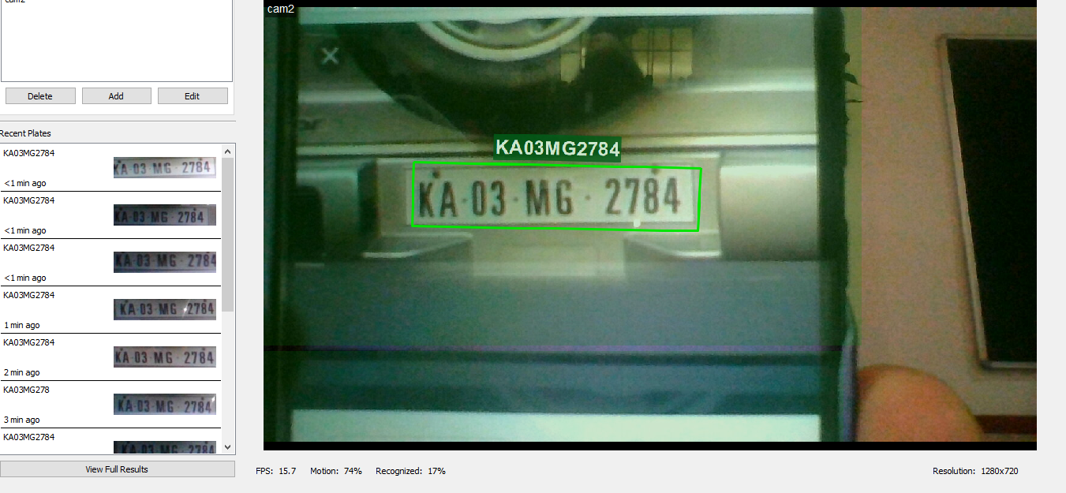
Suspicious Vehicle Detection & Reporting

Slide 10
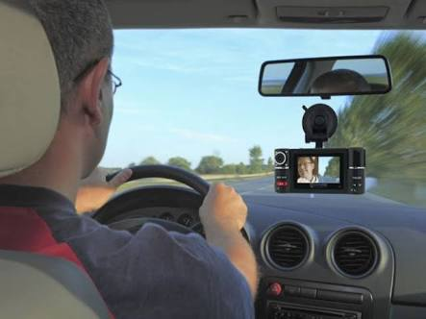
Effective cost of required hardware
A modestly priced camera along with processing unit goes for about Rs.10,000.
We can use speakers of the car itself.

Slide 11
Thank you!!
Raj Kumar Maurya
Madhav Agarwal
Shreyansh Jain
Kunwar Ashutosh Singh
Ashutosh Anand
Amulya Agarwal

